Slide 1
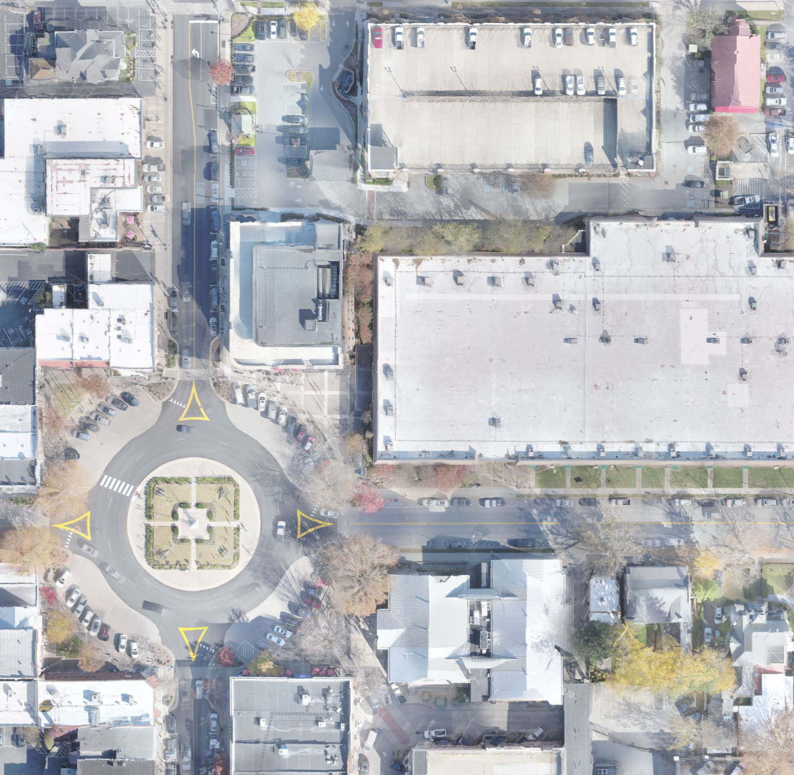
Franklin City Hall
BOMA Work Session
100% Schematic Design
09 January 2024

Slide 2
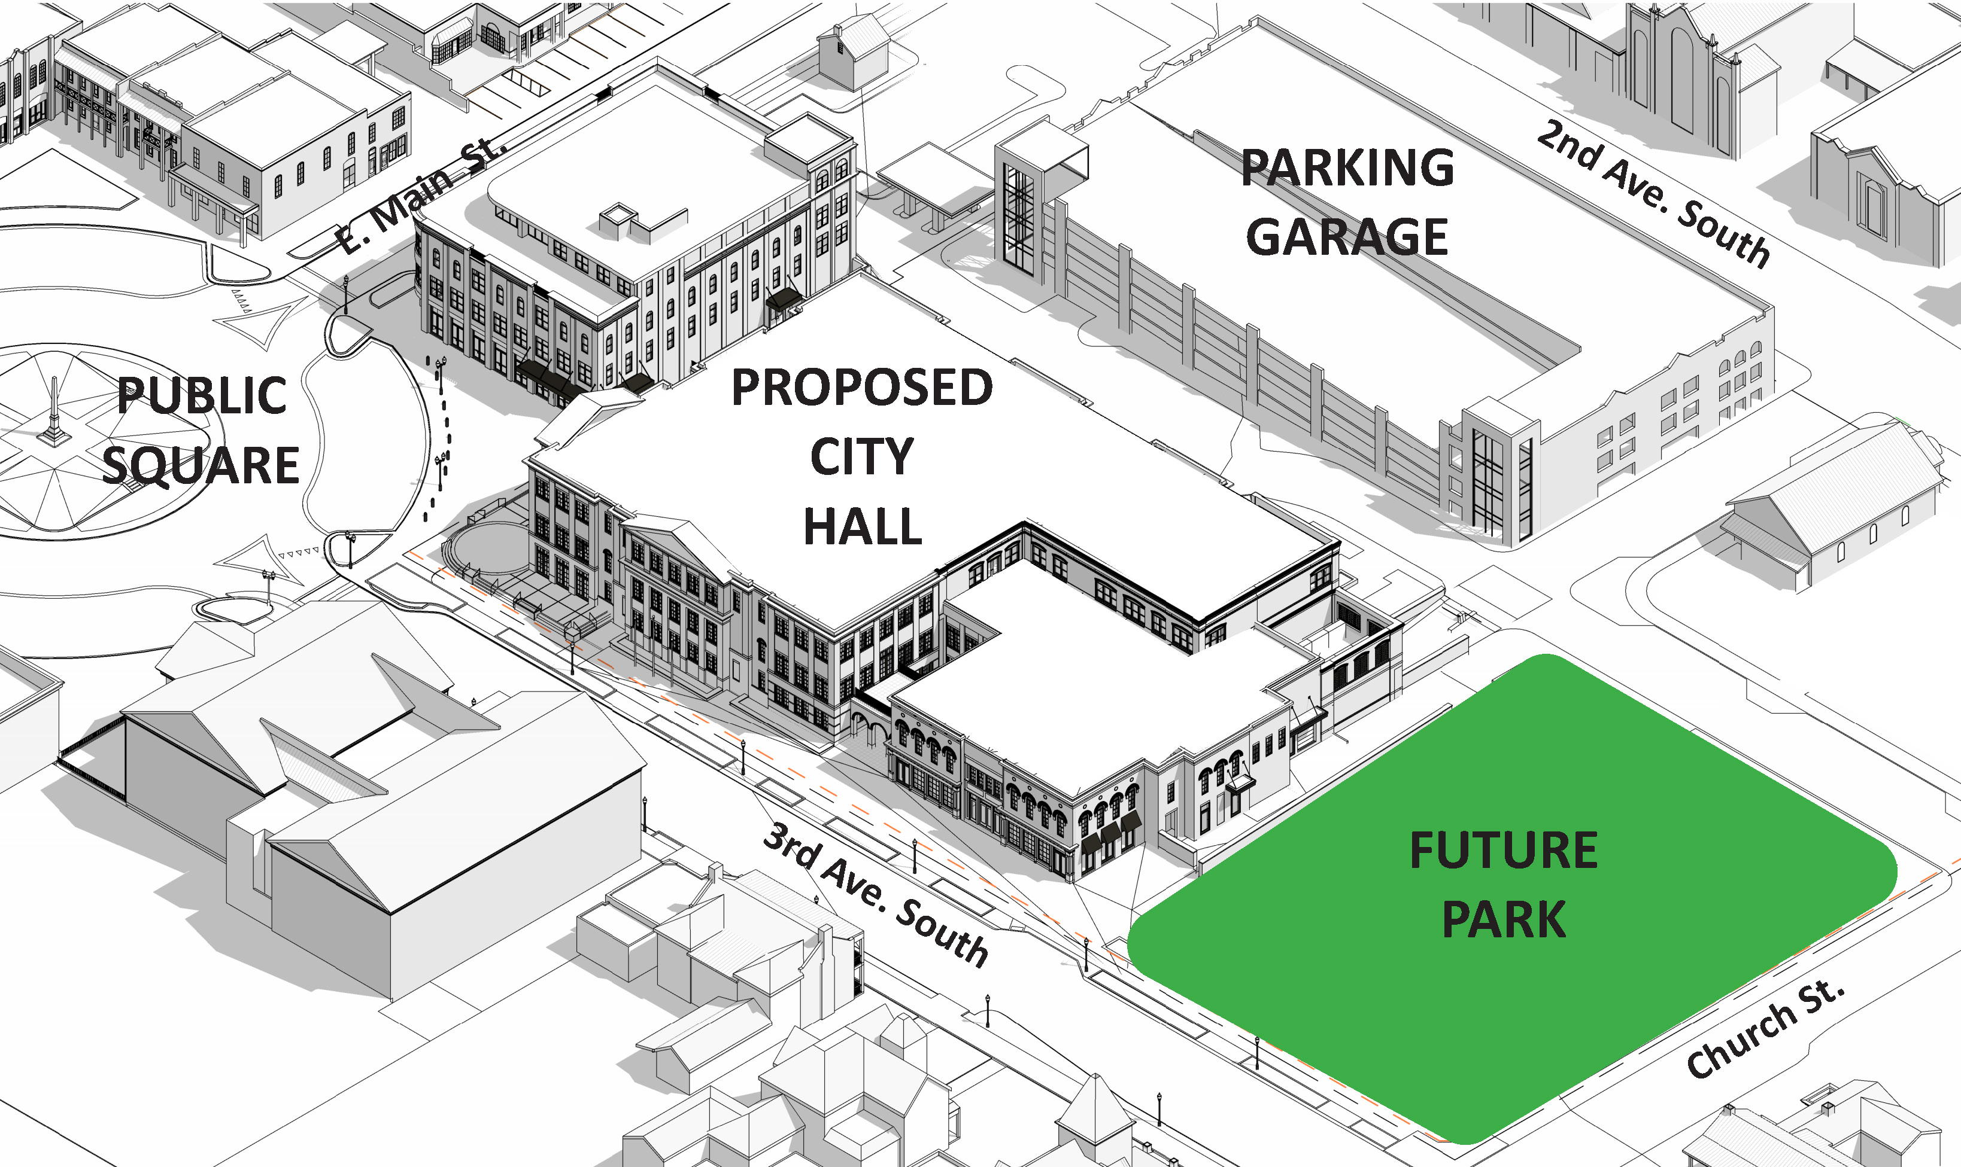

Site Aerial
Commercial Inspiration Image

Slide 3
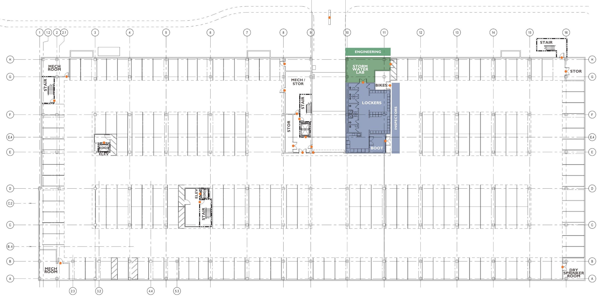
Parking Garage Plan

Slide 4
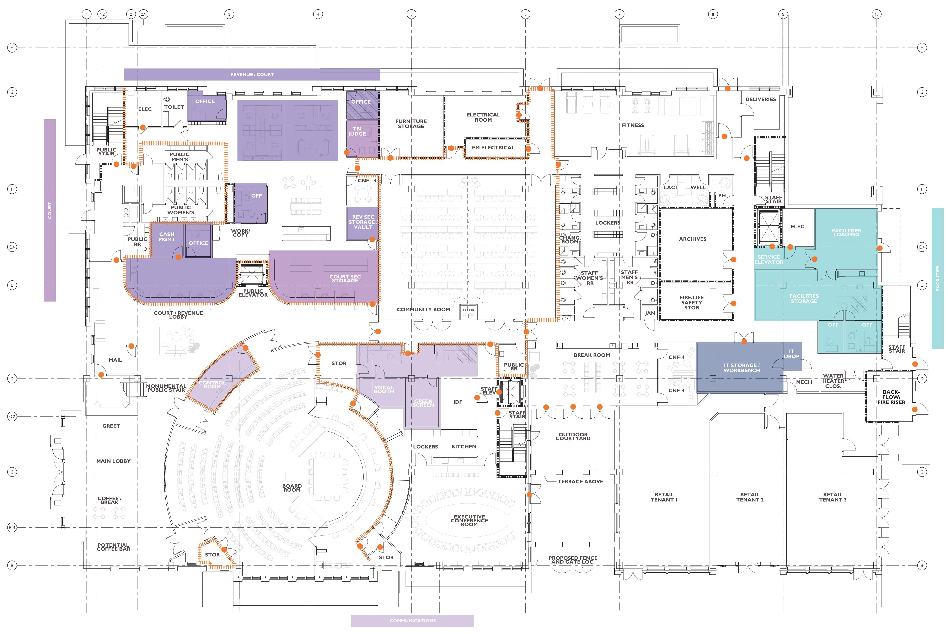
First Floor Plan

Slide 5
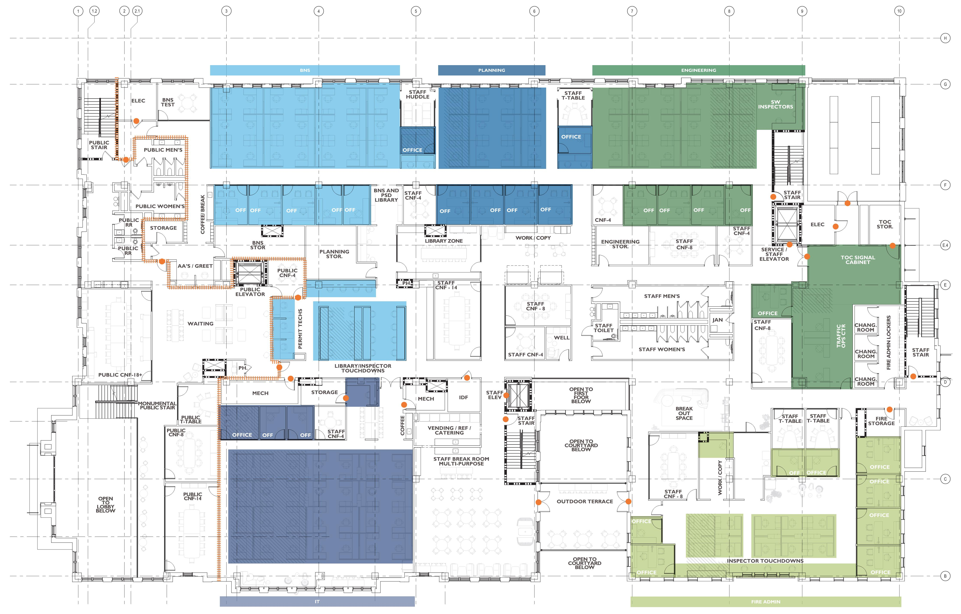
Second Floor Plan

Slide 6
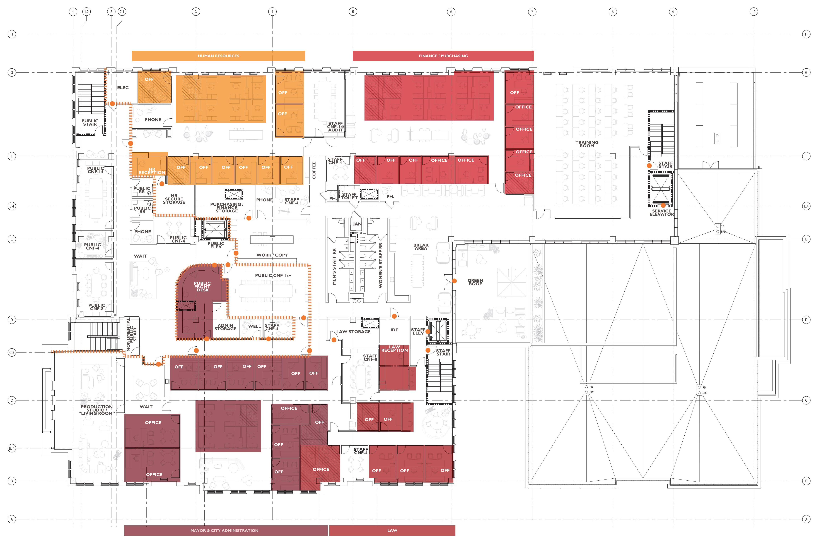
Third Floor Plan

Slide 7
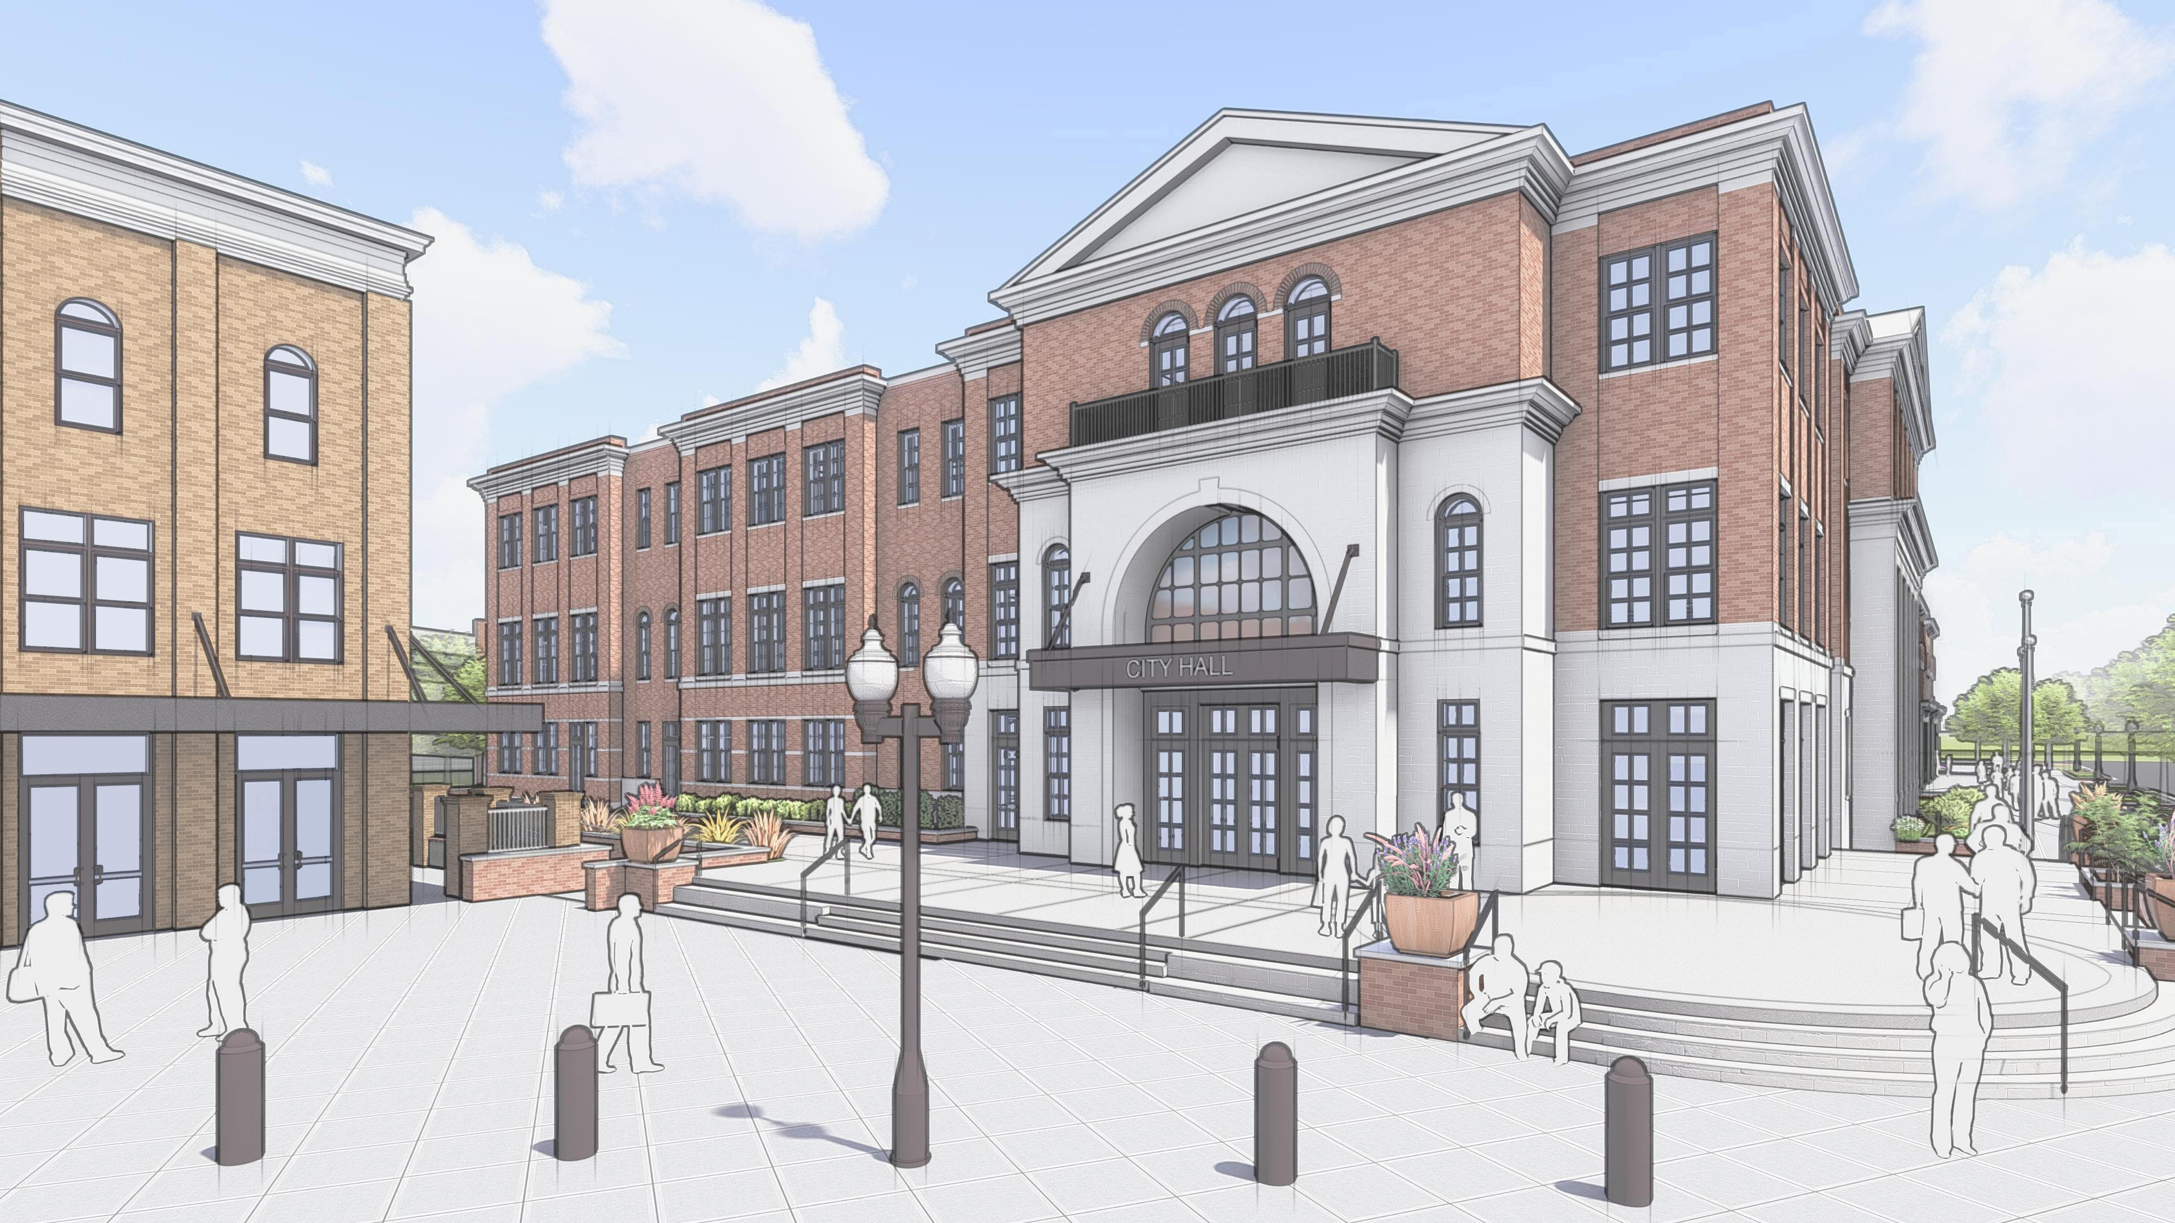

Slide 8
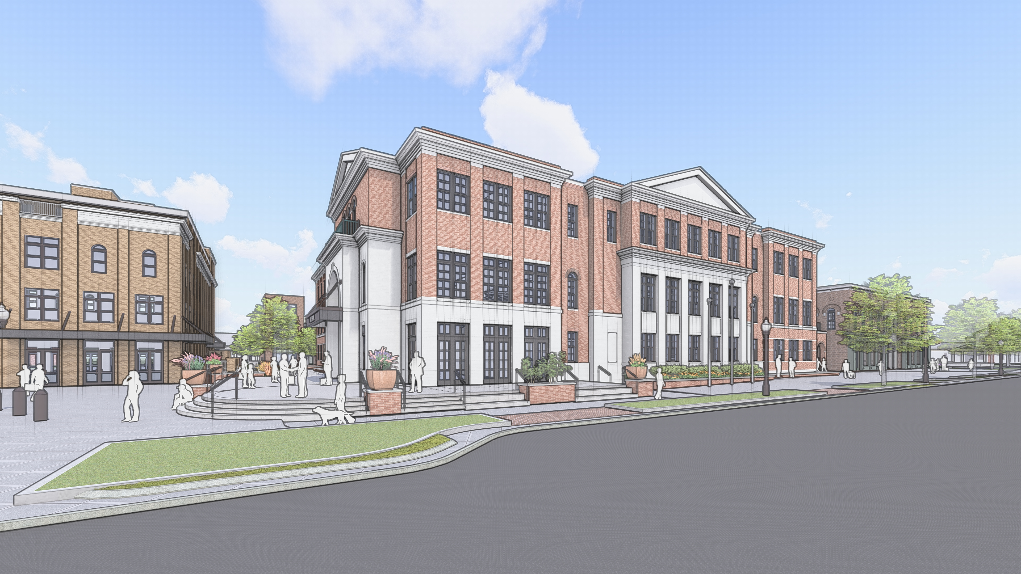

Slide 9
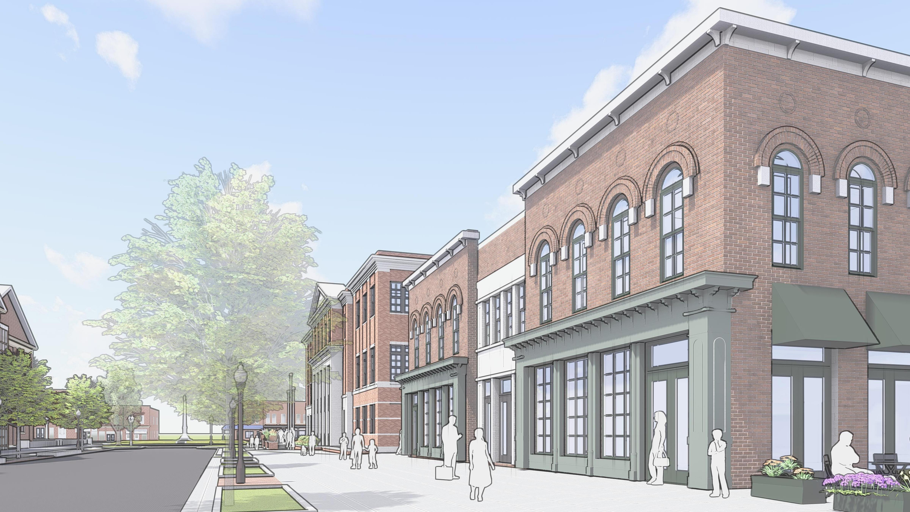

Slide 10
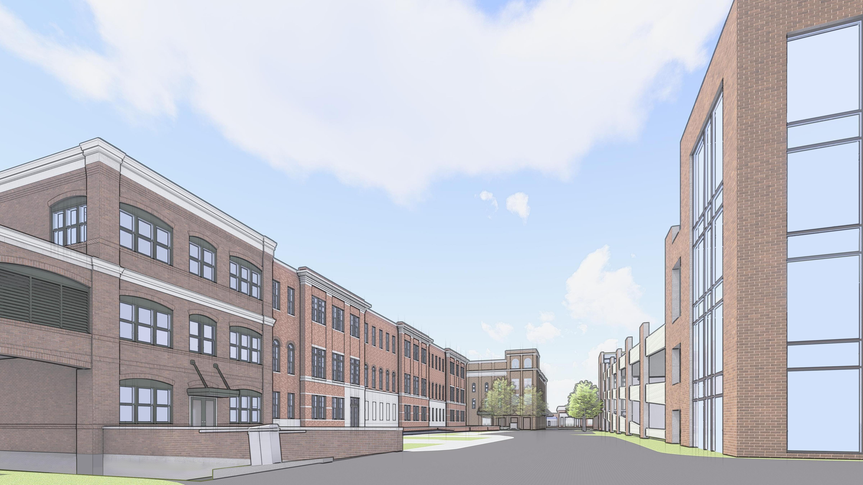

Slide 11
Thank you for your time.
Questions?

