Slide 1
Coordinated Study of Land Use, Infrastructure, and Roadway Network for the Goose Creek Drainage Basin
January 28, 2021 Joint Conceptual Workshop Discussion

Slide 2
Envision Franklin: Managed Growth
Strategic growth is encouraged in locations supported by existing City infrastructure
and services or where they are planned to be provided in an efficient and orderly manner.
The extension of infrastructure and public services should be used as a tool that strategically directs where growth should take place, not as a reactive response to development.
Land-use policies, infrastructure improvements, and community facility investments should be coordinated to maximize efficiency and public benefit while minimizing negative impacts of growth.
Annexation should be approached in a comprehensive manner that promotes contiguity and orderly growth, efficient delivery of municipal services, and proactive planning for future development.

Slide 3
2017 Development Suitability Analysis
I-65 Corridor
Modeled suitability based on nine factors centered on:
Development potential
Proximity to services/ infrastructure
Notes:
The 2017 Development Suitability Analysis formed the foundation for the Design Concepts in Envision Franklin. Read slide. We are focusing in on the Goose Creek area, which is green and suitable for development

Slide 4
2018 Annexation Capabilities Study
LONG
LONG
SHORT
I-65 Corridor
MID
Short-, Mid-, or Long-
Term Capability based on:
Developable acreage
Future land use
Ability to provide services
Magnitude of investment
LONG
LONG
LONG
LONG
SHORT
Notes:
Notes: The 2018 Annexation Capabilities Study looked at X. Annexation laws allow annexation outside of UGB.
Of all the basins in our UGB, Goose Creek has the second highest amount of developable acreage both inside the UGB and outside the UGB (Mayes Creek has highest). Goose Creek is a short-term area and most suitable for development based on staff’s analysis of these factors.

Slide 5
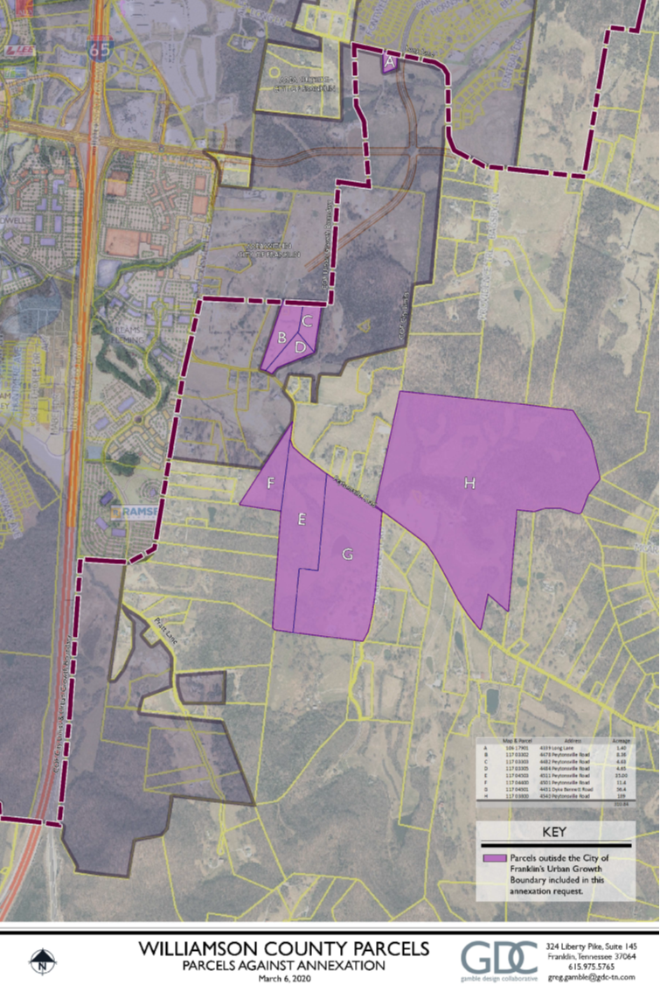
Williamson
County
Ag Center
Highlands At Ladd Park:
1,217 total units
Why now? Why this area??
Berry Farms
Reams Fleming:
400 multifamily units;
2,212,700 sf commercial
2018 City Limits
Area designated Regional Commerce; potential for redevelopment
Basin has second-largest amount of developable acreage
City is making significant investments into this area (fire station, water facility, Long Lane overpass, etc.)
In two years, BOMA has annexed 815 acres outside the UGB
Property owners are ready to develop, and are pressuring staff for answers we don’t have
I-65 Corridor
2019 Annexation:
475 acres
2020 Annexation:
340 acres
Notes:
Notes:
Talk about why this was the right Development Potential
Within UGB (1,800 acres)
Outside of the UGB (2,115 acres)
High interest for property owner annexation
Limitations in current annexation State law
Future Land Use
Some existing County subdivisions on north side
Residential and potentially more commercial
Sewer Service
Infrastructure is in the area to serve with gravity sewer
Sewer extension investment has already been made
Road Infrastructure
Proximity to I-65 and planned major arterial extensions
Pratt Lane improvements near term
Carothers extension near term
Long Lane overpass near term
Peytonsville extension near and mid term sections
Lewisburg Pike improvements long term (up to State)
Emergency Response
Existing fire stations 7 (Goose Creek) and 2 would able to serve adequately

Slide 6
Questions that have been raised:
Will there be an additional interchange? What will be the impact on future land uses?
Can development start anywhere, or is a phasing plan needed?
What capacity do our current infrastructure plans accommodate?
Will the new clean water facility allow for more density in the area?
What natural features do we want to preserve in this area?
How do the contours of the area affect infrastructure and development potential?
Will our impact fees help offset the costs of needed improvements?
Does more land need to be annexed before infrastructure can be extended/improved?
Can development begin without these question resolved?
Notes:
Would suggest maybe a map of current city limits and limits of GC basin outside the UGB
I know this is a skeleton, so let’s think about adding more background somewhere around here about needing a coordinated study as these areas are outside our UGB… Then show what has been done already (with those next slides you have), then back to needing a coordinated study.
Direction of all of this great.

Slide 7
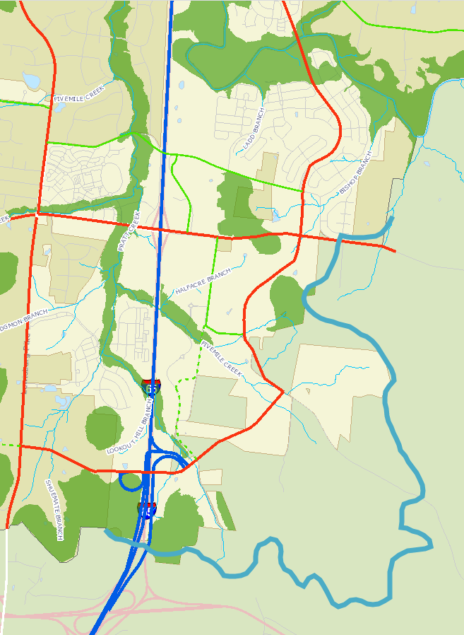
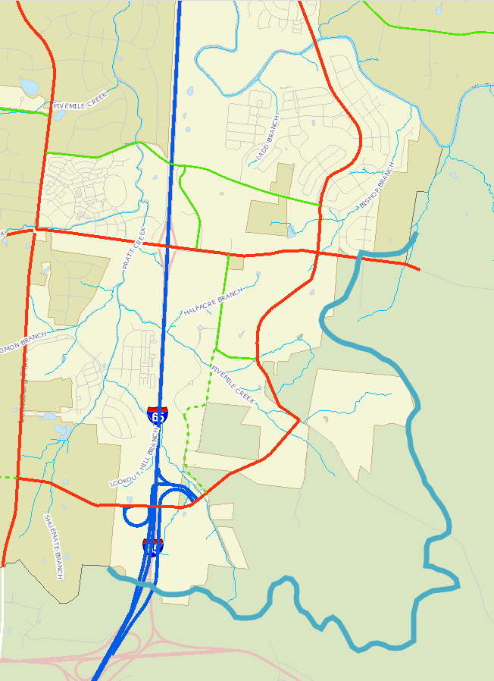
MAJOR THOROUGHFARE PLAN
Of future roadways planned, only the Long Lane Overpass is funded
Future improvements are driven by development, as with all projects within the MTP.
Area includes greater than $40 million of roadway improvements, not including the potential overpass/interchange at I-65
Impact Fees won’t come close to covering this overall price tag.
Property Owner concurrence in the basin
County concurrence with their long-range roadway plan
Investigate transit opportunities
Conservation areas
Limits of sewer basin

Slide 8
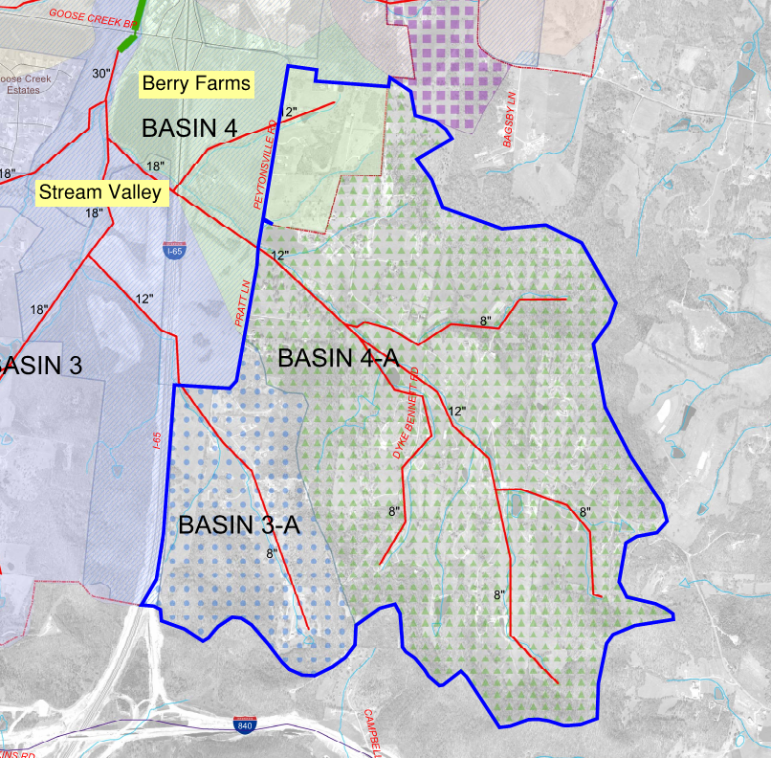
Goose Creek sub-basins
Potential Concerns
Interceptor upgrades
Downstream interceptors potentially need upgrades dependent on increased densities
Proposed interceptor sizes internal to sub-basins are based on November 2004 small area plan
Other potential concerns
Redwing lift station facing upgrades with existing availabilities granted.
Timing of South Water Reclamation Facility may be a factor

Slide 9
Goose Creek sub-basins
Evaluation Needs
Proposed future densities in sub-basins should be determined
Evaluate impact on sizing if sub-basin interceptors
Evaluate impact on downstream interceptors
South Water Reclamation Facility
Increased densities may require increase of planned WRF capacity
Timing of construction of WRF and phasing of development of sub-basins need coordinated
Impact Fees won’t come close to covering this overall price tag.

Slide 10
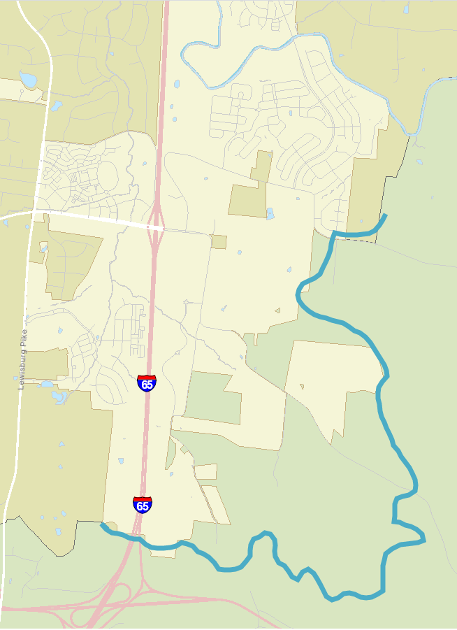
OTHER UTILITY PROVIDERS
Limits of sewer basin
Notes:
Coordinating a study for the larger area means including utilities districts other than the City of Franklin.

Slide 11
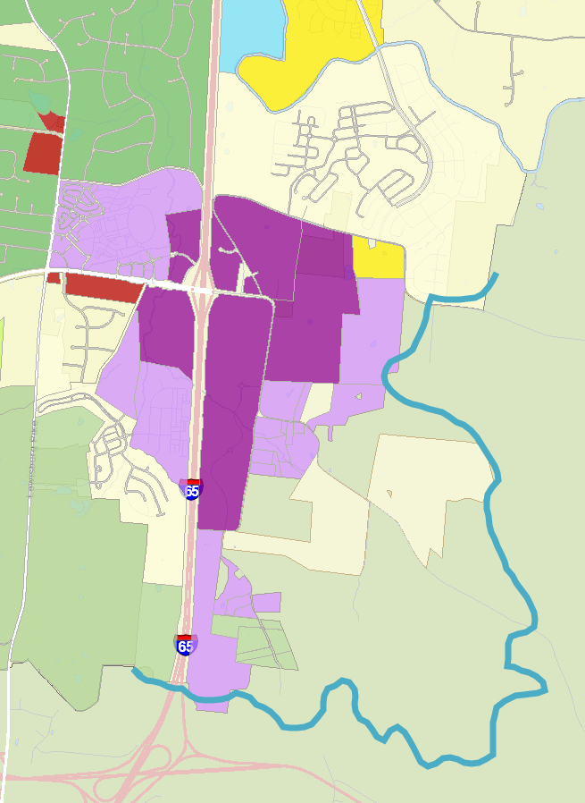
ENVISION FRANKLIN
Policies put in place must be supported by infrastructure
Transitions can only be put in place when a limit or boundary is identified
Expanding the public outreach
Limits of sewer basin

Slide 12
Benefits of a Coordinated Study
Identify the appropriate land uses for area
Plan for an efficient extension of utilities
Plan for future roadway needs
Calculate future costs and funding needs
Proper and comprehensive public outreach
Phase construction of utilities/roadway improvements
Streamline annexation requests
Next Step: request permission from BOMA to proceed with RFQ

