Slide 1
2014-2018 Capital Improvement Plan Overview

Slide 2
Fire Station #8 – Westhaven Development

Slide 3
Columbia Ave - Downs Blvd to Mack Hatcher Pkwy

Slide 4
Franklin Rd – Harpeth Bridge to Harpeth Industrial Court

Slide 5
Fire Station #7 – Berry Farms Development

Slide 6
Mack Hatcher Pkwy - Southeast Quadrant

Slide 7
City Hall

Slide 8
Lewisburg Pike Widening – Mack Hatcher to Donnelson Creek Pkwy

Slide 9
McEwen Dr. Extension – Wilson Pike to Eastern City Limit

Slide 10
Public Restrooms @ Harlinsdale Farm

Slide 11
Del Rio Pike Improvements – Popular Grove Entrance to Carlisle Ln

Slide 12
Carothers South Pkwy – Ladd Park

Slide 13
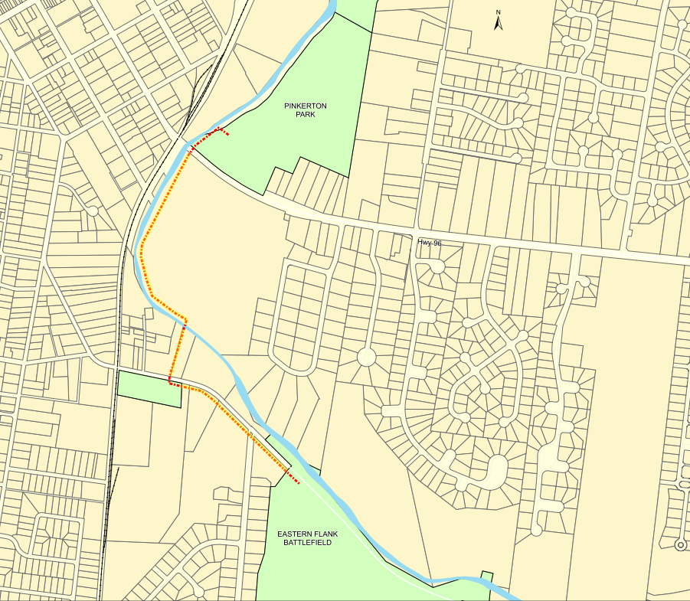
Harpeth River Walk – Pinkerton to Eastern Flank

Slide 14
Long Lane/Old Peytonsville Rd Connection Across I-65

Slide 15
McEwen Dr. Extension – Cool Springs Blvd to Wilson Pike

Slide 16
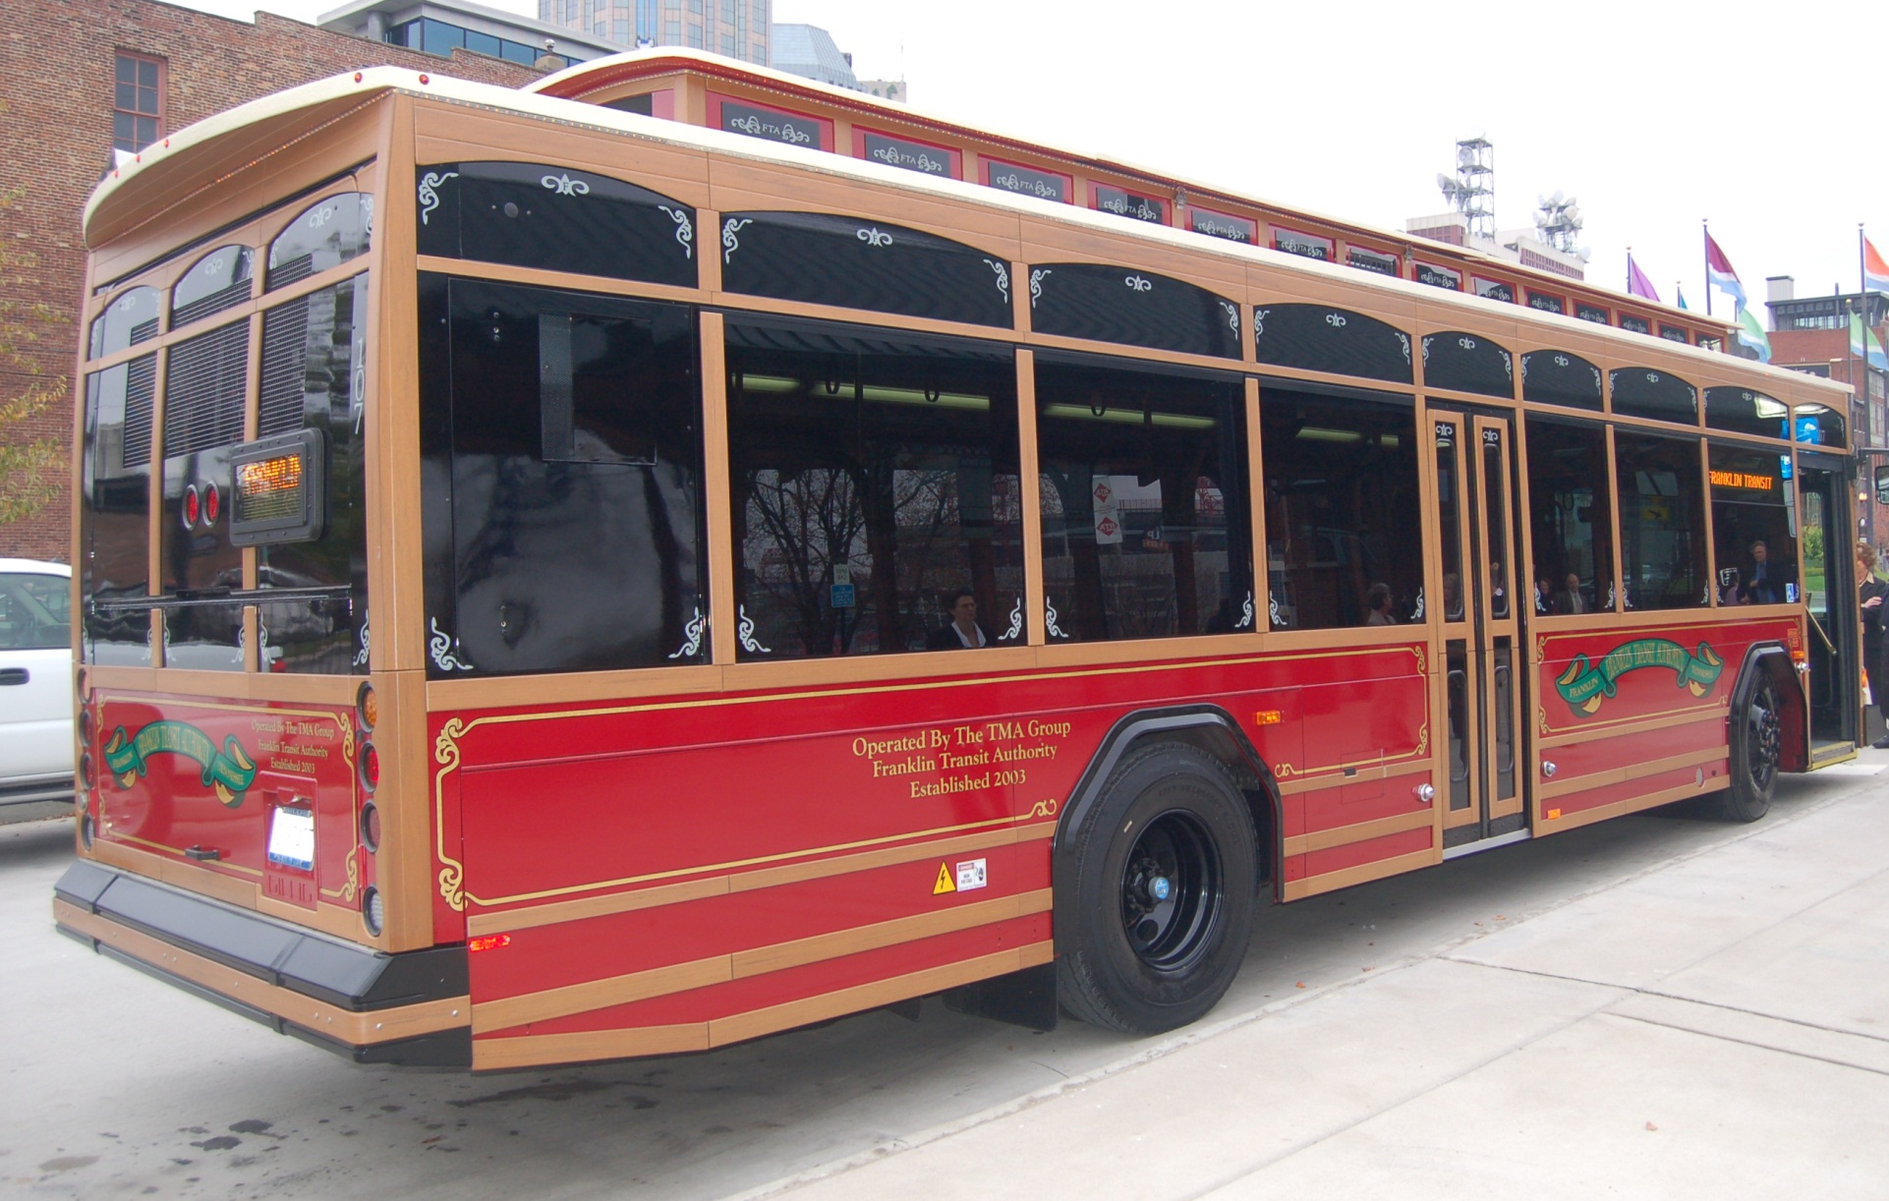
Cool Springs Public Parking to Integrate with Transit Solution

